Slide 1


Slide 2
MMME4054 Week 3 – Attention and Workload
Dr Kyle Harrington

Slide 3
Activity
Please join the Teams group to take part in a later activity and open these slides on your device.

Slide 4
Learning Outcomes
Be aware of various types of attention, and how they might relate to specific tasks
Understand various theories of attention as they relate to Human Factors
Be able to describe workload and its relationship to performance
Discuss various ways that workload can be measured.

Slide 5
Plan
Recap
Attention
Workload and its measurements
Break?
Quiz
Workload Activity
Coursework tips (if time)

Slide 6
Recap 1/2
What did you learn last week?

Slide 7
Recap – Human Information Processing (Wickens, 1998)
Attention resources
Short-term sensory store
Perception
Response selection
Response execution
Thought,
Decision making
Stimuli
Response
Working memory
Long-term memory
Memory
Feedback
Notes:
Spent time on multimodality

Slide 8
Recap – memory – multi-store model
Multi-Store Model of Memory (Atkinson & Shiffrin, 1968)
Sensory Stores
Attention
Short-term store
Rehearsal
Long-term store
Decay
Displacement
Interference
Notes:
Also spoke about memory structures: spatial metaphor vs. parallel distributed processing

Slide 9
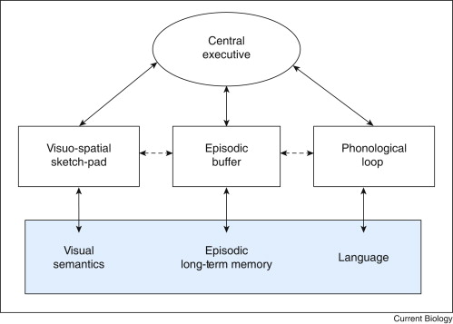
Recap - Memory – working memory
Image source: Baddeley, A., 2010. Working memory. Current biology, 20(4), pp.R136-R140.
Notes:
Baddeley & Hitch (1974)
Replace concept of STM with “working memory”
3 (now 4) Components of working memory
A modality-free central executive resembling attention – assigns attentional resources to other systems & resists distractions.
An articulatory or phonological loop, which holds information in a phonological (i.e. speech-based) form
A visuo-spatial scratch pad (now known as sketch pad) which is specialised for spatial and/or visual coding – holds information in an analog, spatial form.
The episodic buffer – used to retain memories of units of visual, spatial, and verbal information and chronological ordering (e.g., the memory of a story or a movie scene)
Working memory decreases with age.

Slide 10
Recap – memory – working memory cont’d
Baddeley & Hitch (1974)
Replace concept of STM with “working memory”
3 (now 4) Components of working memory
A modality-free central executive resembling attention
An articulatory or phonological loop, which holds information in a phonological (i.e. speech-based) form
A visuo-spatial scratch pad (now known as sketch pad) which is specialised for spatial and/or visual coding
The episodic buffer – used to retain memories of units of visual, spatial, and verbal information and chronological ordering (e.g., the memory of a story or a movie scene)
Notes:
Skipping over memory stores – Atkinson and Shiffrin- iconic echoic; short-term; long term
Also 7+/- 2
Primacy/recency

Slide 11
Learning objectives – Attention and Workload
Lecture objectives:
Provide a brief overview of theories of attention
Explain different types of attention and their relevance in design​
Introduce mental workload and its measurement
Consider the above in the context of design

Slide 12
Recommended reading
Wickens, C.D. (1992) Engineering Psychology and Human Performance. New York: Harper Collins​ - chapters on attention and workload
Eysenck, M.W. & Keane, M.T. Cognitive Psychology: A Student’s Handbook. Hove: Lawrence Erlbaum Associates

Slide 13
Attention
Attention resources
Short-term sensory store
Perception
Response selection
Response execution
Thought,
Decision making
Stimuli
Response
Working memory
Long-term memory
Memory
Feedback

Slide 14
Attention - definitions
Introduction​
Humans have several channels of sensory input​
One input channel can receive many pieces of information​
Definitions​
No precise definition available​
Concept of “selectivity”, focus of mental effort​
Cognitive process involved in shift of mental effort​
It is possible to (apparently) concentrate on more than one thing at a time​
Not always conscious of making decision about where attention should be focussed

Slide 15
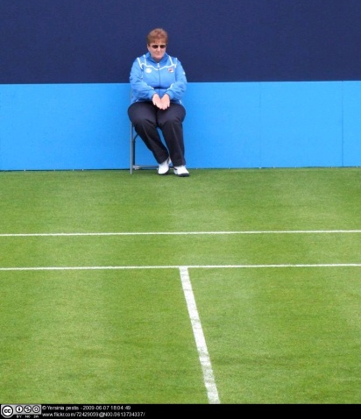
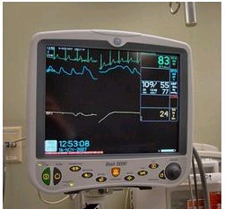
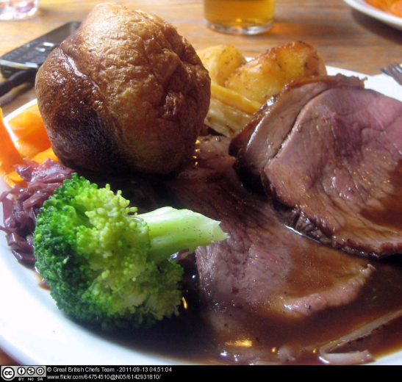
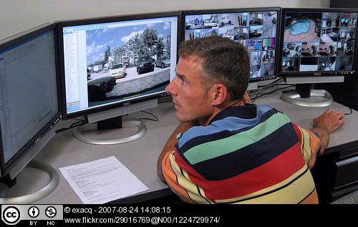
Attention – different types
Selective attention Our ability to selectively attend to a stimuli while ignoring irrelevant stimuli. | Focused attention Our ability to have our attention “caught” by a specific stimulus; ability to concentrate on a stimulus.
Divided attention Two or more separate tasks must be performed simultaneously and attention must be paid to both | Sustained attention Monitoring or vigilance tasks requiring the detection of infrequently occurring signals over prolonged periods of time (Signal detection theory)

Slide 16
Can we really “Multi-task”
Divided attention is required to multi-task (perform multiple tasks simultaneously), but exactly how well can we do it?
Is it actually “task-switching? – There are time and cognitive costs, and an impact on productivity (Lou, J. D, 2018)
People who multitask make more errors, and have less awareness of their own performance (Konishi et al 2021)
fMRI studies support the idea that performance declines during multitasking (Hashimi, Zanto & Gazzaley, 2015)
Frequent multitasking impacts attention tasks, and those who frequently multitask are actually worse (Sanbonmatsu et al, 2013)

Slide 17
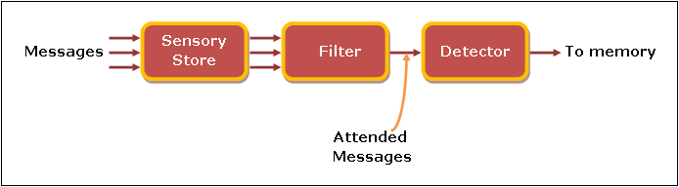
Attention - models
Broadbent
Inputs selected at early stage of processing, on basis of physical characteristics (e.g. pitch of voice, position of speaker etc.)
Cocktail Party Effect
Ability to hold individual conversations despite number of other noises present in room
Broadbent model – image from: 17.7 Broadbents Early Selection Theory (detsndt.ac.in)

Slide 18
Treisman
Treisman
Three types of processing until inputs distinguished:
Physical characteristics of stimuli assessed
If linguistic – separate into syllables and words
Assign meaning to stimuli
Non-selected stimuli attenuated – not completely rejected
Attended ear | Unattended ear
In the picnic basket she had peanut butter book, leaf, roof, sample, always…. | Cat, large, day, apple, friend, every, select, sandwiches and chocolate brownies
Notes:
People asked to attend one ear…read these words…what they heard is underlined…thus people don’t only attend the intention, but the meaning.

Slide 19
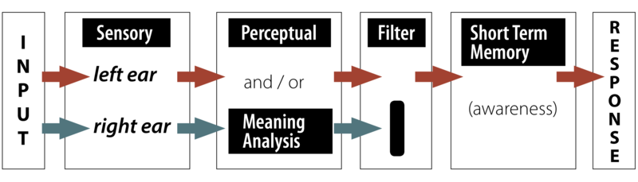
Attention – models cont’d
Late selection model: image taken from:
Attention – PSYC 100: Principles of Psychology F21 (pressbooks.pub)
Late Selection​
All stimuli processed​
Selection occurs in working memory​
Capacity models of attention​
Attention = set of cognitive processes for categorising and recognising stimuli.​
Cognitive resources = limited​ Practice – reduces the level of resources necessary to complete task​
Notes:
From ecampusontario:
Late Selection Models
Other selective attention models have been proposed as well. A late selection or response selection model proposed by Deutsch and Deutsch (1963) suggests that all information in the unattended ear is processed on the basis of meaning, not just the selected or highly pertinent information. However, only the information that is relevant for the task response gets into conscious awareness. This model is consistent with ideas of subliminal perception; in other words, that you don’t have to be aware of or attending a message for it to be fully processed for meaning.
Figure 3You might notice that this figure looks a lot like that of the Early Selection model—only the location of the selective filter has changed, with the assumption that analysis of meaning occurs before selection occurs, but only the selected information becomes conscious.
Kahneman identifies his theory as a capacity theory of attention, meaning: (1) attention is not an unlimited resource and (2) attention is a shared resource.

Slide 20
Attention – Lavie et al., 2004
Load theory of attention (Lavie et al., 2004)​
Distractor rejection depends on the level and type of load involved ​
2 selective attention mechanisms: ​
a perceptual selection mechanism serving to reduce distractor perception in situations of high perceptual load and ​
a cognitive control mechanism that reduces interference from perceived distractors as long as cognitive control functions are available to maintain current priorities (low cognitive load).
Notes:
A load theory of attention in which distractor rejection depends on the level and type of load involved in current processing was tested. A series of experiments demonstrates that whereas high perceptual load reduces distractor interference, working memory load or dual-task coordination load increases distractor interference. These findings suggest 2 selective attention mechanisms: a perceptual selection mechanism serving to reduce distractor perception in situations of high perceptual load that exhaust perceptual capacity in processing relevant stimuli and a cognitive control mechanism that reduces interference from perceived distractors as long as cognitive control functions are available to maintain current priorities (low cognitive load). This theory resolves the long-standing early versus late selection debate and clarifies the role of cognitive control in selective attention.

Slide 21
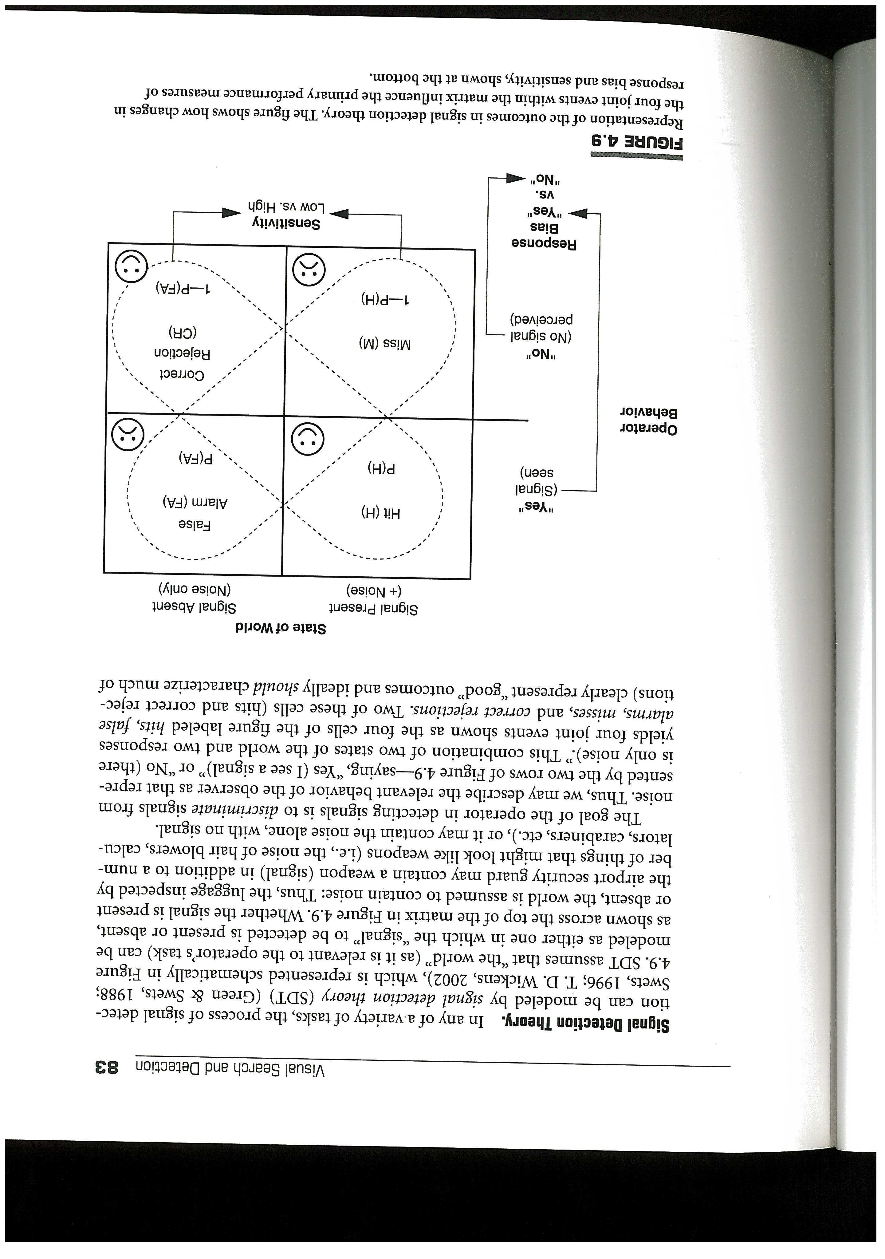
Signal detection theory
Detection of signals in ‘world’​
Assumption of noise present in world​
E.g. non dangerous items in luggage​
Aim: discriminate signals from noise​
Four outcomes: ​
Hit (signal present)​
Correct rejection (only noise present)​
False alarms (think signal present when not)​
Miss (fail to detect signal that is present)​
Notes:
From Basics of Signal Detection Theory (hanover.edu)
Background
Consider the following situation: You are driving down the road, and you think you heard a sound that might have come from the engine. Say it sounded kind of like a clunk. Now, you have your stereo going, and there are sounds from the road, so you are not sure. If you car is relatively new and has a history of smooth running, perhaps you will decide that you didn’t really hear anything. Your hearing is “playing tricks” on you. Perhaps instead of the fine automobile described above you are driving an old car that has a history of spending nearly as much time in the shop as on the road. In this case, you might decide that you did hear something and head to the nearest service center. What is important in this example is that even in this very basic sensory discrimination, there is a cognitive decision-making element that needs to be taken into account.
Signal detection theory attempts to understand the role that decision making plays in these situations. Examine the situation above a little more carefully. All the possible outcomes are shown in Table 1(a). In the real world, the stimulus event does not always occur. So it is possible that the clunk either occurred or did not. These two possible stimulus events are indicated across the top of the table. In either case, and to some extent independently, of whether the clunk happened or not, you can decide that you heard the clunk or not. These possible judgments on your part are shown on the left-hand side of the table. The four cells of the table are the possible outcomes. For example, the clunk could have happened, and you could decide that you heard the clunk and so you go get the car serviced. That outcome is in the upper left hand cell of the table. Thus, two of the outcomes, deciding the sound occurred when it did and deciding the sound did not occur when it did not, are correct responses and have positive outcomes; the other two outcomes represent incorrect decisions and have negative outcomes. It is, of course, in your best interest to maximize the positive outcomes while minimizing the negative outcomes.

Slide 22
Lazy Brain!
The human brain does not need to attend to, remember or store every detail in the world, looking to see if it changes (in an artificial way).
The world itself is a reference (so why would the brain store everything?)
The brain can be tricked because it optimises efficiency.
Don’t need to store everything “in the head”.
People are often unaware that the world changes, “anti-representationalism”.
Reference on change Blindness (Resink, O’Regan and Clark, 1997)

Slide 23
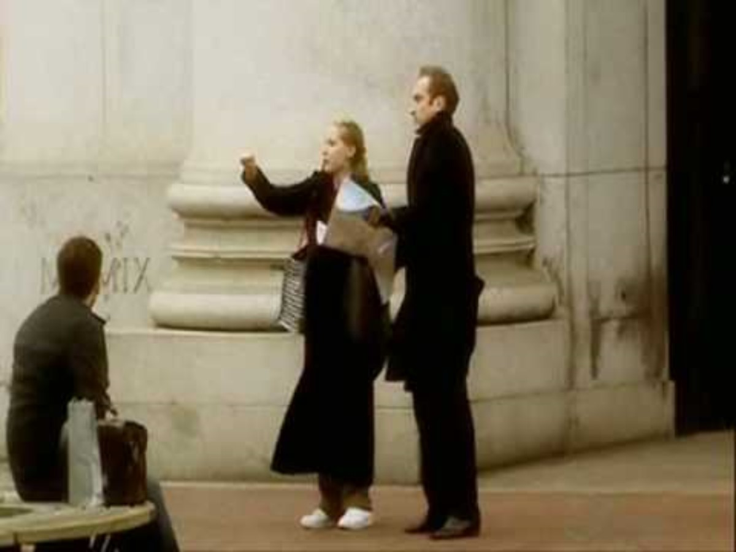

Slide 24
Implications for design - attention
Considering relationship between design and attention ​
Both appropriate and inappropriate ‘drawing’ of attention​
Using a multimodal approach​ (less interference)
What are the “costs” of task switching?
Understanding the need to sustain attention during longer interactions
Human operators are provided with so much information that they need to know:​
Which information must be attended to​
Which information can be ignored safely

Slide 25
Human Workload Theory
How busy is the operator?​
How complex are the tasks?​
Can any additional task be handled above and beyond those that are already performed?​
Will the operator be able to respond to uncertain stimuli?​
How does the operator feel about the tasks being performed?​
Mental Workload Assessment​
Designed to measure load placed upon cognitive capabilities

Slide 26
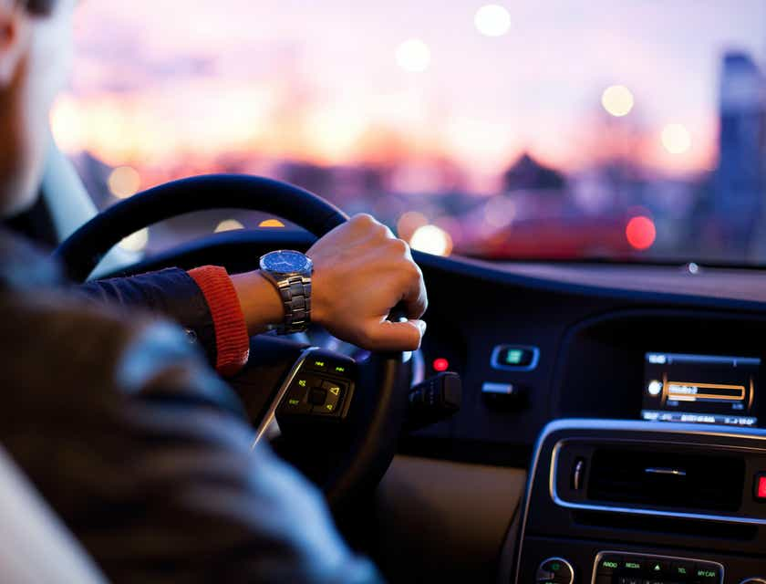
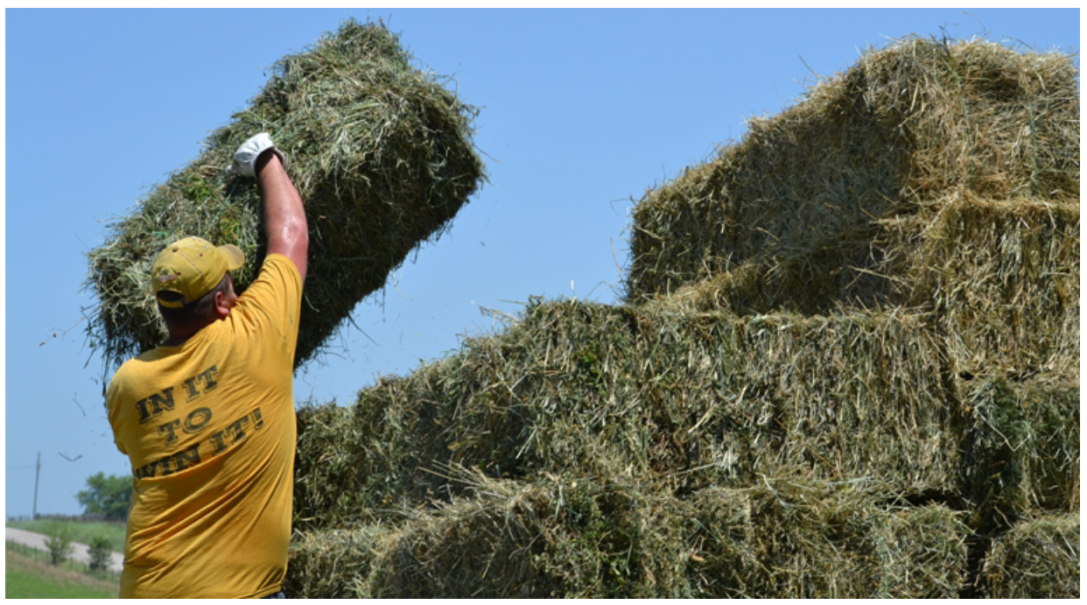
What is workload for these jobs? Slide 1 of 2
Hay Day Memories (The nostalgia of square bales) - Agridirect | agridirect.ie
ACTIVITY!!!!
Driver Job Description (betterteam.com)

Slide 27
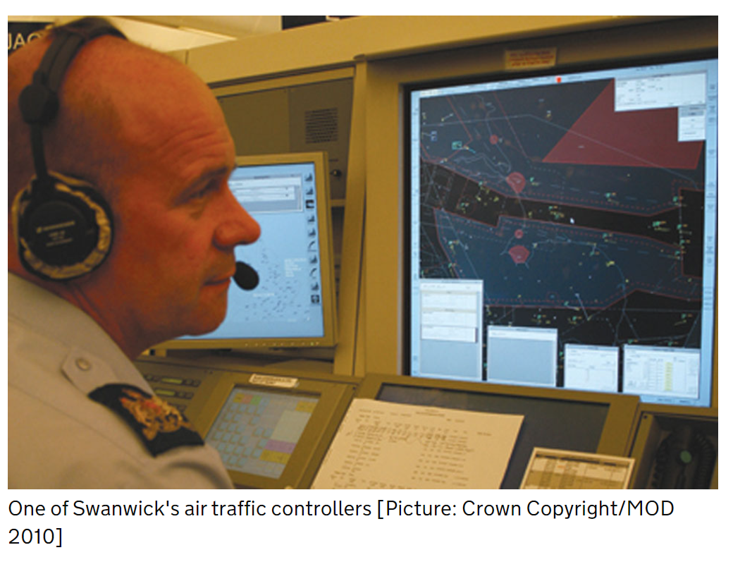

What is workload for these jobs? Slide 2 of 2
Woman Office Worker on Mac Royalty Free Photo (negativespace.co)
RAF and civilian air traffic controllers working together - GOV.UK (www.gov.uk)
Notes:
“In 2020/21 work-related stress, depression or anxiety accounted for 50% of all workrelated ill health.” - HSE

Slide 28
Human Workload - defintion
a limited quantity of resources are available to perform a task, and in order to perform a task, one must use some or all of these resources​
Definition​
No universally accepted definition, but basic notion is related to the difference between amount of resources available within a person and amount of resources demanded by task situation.​
Therefore may be affected by either task demands or resources available.

Slide 29
Limited resources model
Limited resources model
Impact of underload on performance
Dip in performance whilst still spare capacity due to data limitation
Good
Variable level of
available
resources
Less graceful decline in performance – ‘precipice of performance’
Performance
Resources
allocated
Variation in rate at which resources allocated due to expertise
Poor
Resources demanded by the primary task
Notes:
Resources available can vary (e.g. fatigue, motivation)
Expert uses up resources more slowly
Underload can degrade performance (through either lowered arousal or reduced attentional resources)
Precipice – research in ATC suggests degradation in performance is not constant.
Resource vs. data-limited performance. Resource limited – don’t have enough attention to attend to all tasks. Data limited – can’t perceive fault due to perceptual limitations in visual processing.
There is a work context – usually more than one task. Therefore task switching, and associated task switch cost.

Slide 30
Theorised relationship between resource supply and demand (Wickens, 1992)
SPARE CAPACITY
OVERLOAD
Resource supply
MAX
Performance
Resource demand
Notes:
X axis = demand, primarily externally defined – changing from driving on straight road to driving around curves
Y axis = 2 things: 1) supply – what you can bring to the task –if less skilled have less; if impaired in some way (alchol; tired) have less
2) Performance initially stays static - as demand increases – supply increases to meet it – but has maximum level –at some point will approach that and performance will start to suffer – tired and driving on curves while also having to press buttons in the car
Pass the red line
Many workload measures are essentially based on this theoretical view – especially performance (performance only really relevant in the overload scenario) and secondary task measures (relevant in both – do something else and look at effects on ST)
Problems
- view of what is actually a resource (how does this relate to what is going on in the brain?)
- red line is actually very fuzzy
- supply highly dynamic

Slide 31
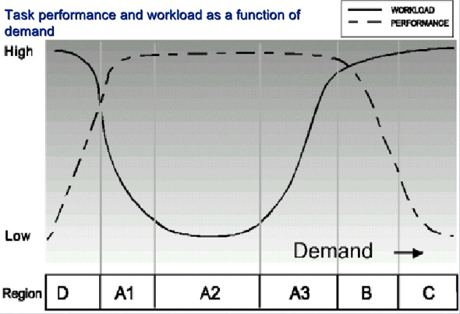
Theorised relationships between workload and performance (De Waard, 1996)
Notes:
Important because different measures relevant to different regions
D + A1 = low task demands (e.g. driving on straight road) – WL can be high as sustained attention (monotonous task – common in driving) – supply may be low – struggle to maintain performance (effort not put in) – fatigue (sleepiness) – deactivation (underload)
Workload and performance in 6 regions In region D (D for deactivation) the operator's state is affected. In region A2 performance is optimal, the operator can easily cope with the task requirements and reach a (self-set) adequate level of performance. In the regions A1 and A3 performance remains unaffected but the operator has to exert effort to preserve an undisturbed performance level. In region B this is no longer possible and performance declines. In region C performance is at a minimum level: the operator is overloaded.
D/A1 = Fatigue area – predicting underload (sleepiness)
A3/B/C = distraction/overload

Slide 32
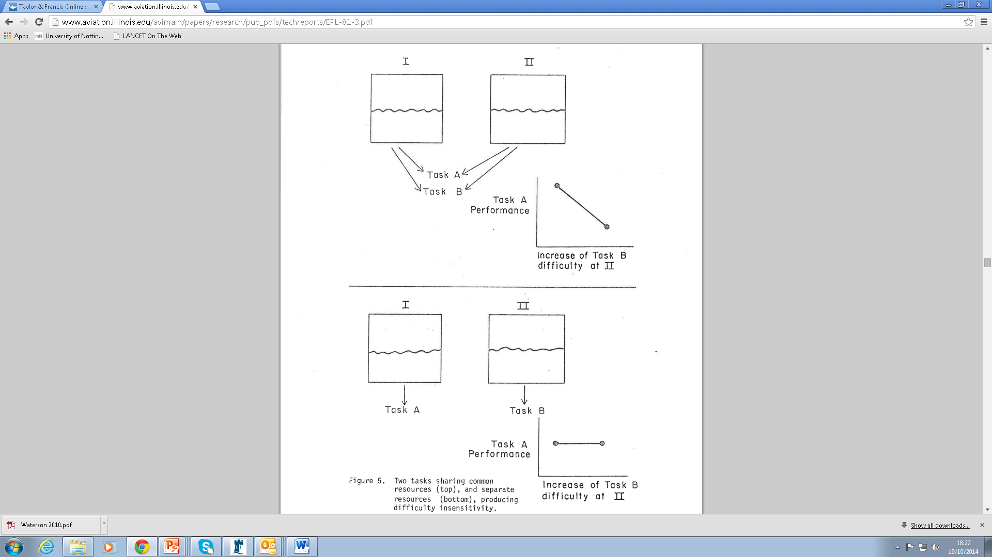
Dual task paradigm
LEFT
RIGHT
http://www.aviation.illinois.edu/avimain/papers/research/pub_pdfs/techreports/EPL-81-3.pdf
Notes:
Pre-curser to multiple resources theory. This is the notion that if tasks draw from the same “reservoir” of resources (e.g. two conversations) then performance on one will deteriorate as difficulty of the second increases. However, if the tasks draw from distinct resources (e.g. driving and talking) performance on one may remain relatively unaffected as the difficulty of the other increases.

Slide 33
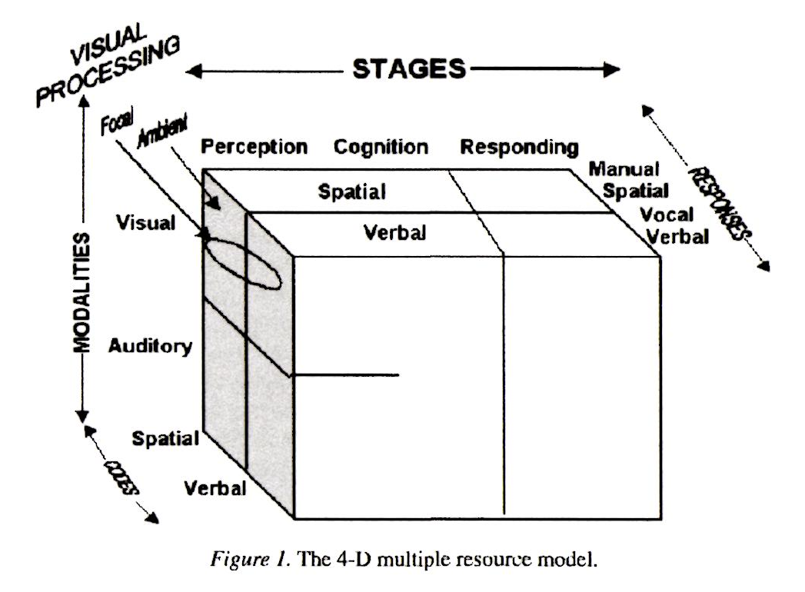
Multiple resources theory (Wickens, 2008)
Notes:
Wickens 2008 – most important application is to suggest design changes when in conditions of multitask overload
Mid 70s – evidence for more than 1 pool of resources
Wickens created this model (or rather the first version of this model 1980s) based on a meta-analysis of performance sharing studies.
The less tasks share resources, the better timesharing will be.
Auditory spatial – locating something
Auditory verbal – speech
Visual spatial – navigation
Vocal=voice; verbal=words
Visual verbal – reading
Visual focal (foveal)/ambient (peripheral)
Future work: add a tactile modality dimension; understanding the factors that occur in addition to resources that affect dual task performance; understanding what drives attentional allocation (e.g. when to respond to interruptions).

Slide 34
Measures of mental workload
Primary task measures
e.g. measure how driving is affects by different task demands – measure driving performance task
Secondary task measures
Operator is required to do extra task in addition to primary task.
Difficulty with secondary task indicates level of demand of primary task
Subjective Rating measures
Direct or indirect queries of individual for opinion of workload involved in a task
Physiological or Psycho-physiological measures
Measurement of changes in physiological parameters thought to indicate change in Mental Workload

Slide 35
Categories of mental workload measure commonly used
Primary task performance/behaviour
Secondary task performance
Artificial STs
Mental workload
Electro-physiological
Embedded STs
Physiological
Brain Imaging
Subjective
Uni-dimensional scales
Hemodynamic
Visual scanning
Multi-dimensional scales

Slide 36
Considerations in selection of MWL assessment method
Sensitivity
Ability to detect changes in MWL experienced by an operator
Diagnosticity
Indication of nature of workload change
Validity
Ensure that method is measuring change in MWL (i.e. no interference from other changes, such as physical workload)
Reliability
Whether measures are stable and consistent over period of time
Intrusiveness
If measure interferes with task performance, contaminated MWL measure is obtained. E.g. measure may add to MWL
Ease of use
Both for participant and experimenter (e.g. analysis of psychophysiological data)
Operator acceptance
Need to explain measures, ensure no change in performance due to monitoring

Slide 37
Primary task measures Slide 1 of 2
Based on assumption that humans have limited processing capacity or resources (e.g. Kahneman, 1973) and task performance requires processing capacity (Norman & Bobrow, 1978)
As task demands increase, performance will deteriorate
Multiple Measurement
Use several measures of primary task performance
Can take into account individual differences in operator style and strategy
General considerations
Primary measures can be unreliable
MWL may increase while performance is unchanged
Task-specific
Individual differences
High face validity

Slide 38
Secondary task measures Slide 1 of 2
Based on assumption of limited capacity of human to gather and process information
Secondary task = task operator required to do in addition to primary task
Loading
Participant is instructed to aim for error-free performance on secondary task at expense of primary task.
If capacity is reached, primary task performance is degraded
Non-loading
Participant is instructed to avoid making errors on primary task
Operator attends to secondary task when time available

Slide 39
Secondary task measures Slide 2 of 2
Examples of secondary tasks
arithmetic addition
repetitive tapping
choice reaction time
critical tracking tasks
handwriting analysis
General considerations
Intrusiveness
high face validity
primary and secondary tasks must use same type of resources
individual differences
motivation

Slide 40
Limited resources
Primary task performance
Good
Maximum available resources
Performance
Spare capacity
Resources allocated
Resources allocated to primary task
Poor
Resources demanded by the primary task

Slide 41
Subjective rating measures
Operators required to rate level of mental effort that they feel is required to accomplish a task
rating scales
interviews/questionnaires
Unidimensional: General index of MWL
Multidimensional: Diagnostic information pinpointing nature of workload
Immediate: After performing task
Retrospective: Comparison of task conditions
Absolute: MWL “level”
Relative: Compare to standard or other task conditions

Slide 42
NASA-TLX
Multidimensional scale (& total workload score)
Mental demand (how much mental and perceptual activity was required)
Physical demand (how much physical activity was required)
Temporal demand (how much time pressure was felt due to the rate or pace at which the tasks or task elements occurred)
Effort (how hard did you have to work?)
Performance (How successful do you think you were in accomplishing the goals of the task set by the experimenter?)
Frustration level (How insecure, discouraged, irritated, stressed and annoyed versus secure, gratified, content, relaxed and complacent did you feel during the task?)

Slide 43
Subjective Workload Assessment Technique (SWAT)
Time load
Often have spare time. Interruptions or overlap among activities occur infrequently or not at all
Occasionally have spare time. Interruptions or overlap among activities occur frequently
Almost never have spare time. Interruptions or overlap among activities are frequent or occur all the time
Mental effort load
Very little conscious mental effort or concentration required. Activity is almost automatic, requiring little or no attention
Moderate conscious mental effort or concentration required. Complexity of activity is moderately high due to uncertainty, unpredictability, or unfamiliarity. Considerable attention required
Extensive mental effort and concentration are necessary. Very complex activity requiring total attention
Psychological stress load
Little confusion, risk, frustration, or anxiety exists and can be easily accommodated
Moderate stress due to confusion, frustration, or anxiety noticeably adds to workload. Significant compensation is required to maintain adequate performance
High to very intense stress due to confusion, frustration or anxiety, High to extreme determination and self-control required

Slide 44
Physiological measures
Evoked Brain Potential (e.g. EEG, fMRI)
Examine amplitude and latency elements of elicited brain wave
e.g. amplitude reduction when workload increased
high validity
direct reflection of information processing ability
Susceptible to noise interference individual differences
expensive, specialist equipment required
Heart rate Variability
HR data scoring or spectral analysis
Very sensitive
Relatively simple to administer and analyse in comparison with other physiological techniques
Pupil diameter
Body chemical analysis
Auditory canal temperature

Slide 45
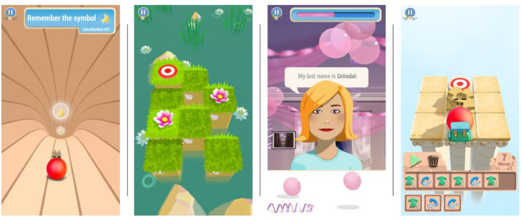
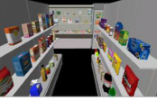
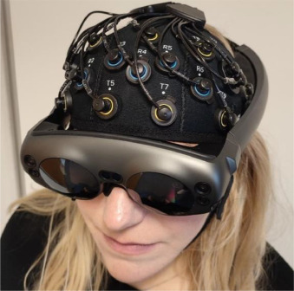
Case Study
Landowska, Wilson, Craven & Harrington (2024), Adaptative computerized cognitive training decreases mental workload during working memory precision task - A preliminary fNIRS study
Participants given brain training program, that either became more difficult (adaptive) or remained at the same level of difficulty over the course of 8 weeks.
We were interested in finding out whether participants increased cognitive skills (memory, problem solving, etc), both in trained tasks and a relevant transfer task (AR Shopping).
One of the results obtained demonstrated lower activity in the pre-frontal cortex during trained tasks, which we can assume correlates with decreased workload.
Some of these effects persisted after a 4 week follow-up.

Slide 46
Email and workload
The relationship between email overload and stress is well-established in the literature (e.g. McMurty, 2014)
(Possible) Contributing factors:
High volume of email, Perceptions of an expected prompt response, competition for attention when trying to work on other tasks, total time spent on email (Dabbish and Kraut, 2006; Jerejian et al., 2016; Gupta et al., 2010; Mark et al., 2016; McMurty, 2014)
Personal factors: Propensity to worry (Jerejian et al., 2013) or viewing email as a business critical tool (positive affects)(Sumecki et al., 2011).

Slide 47
Email and interruptions
In a survey of 16 employees’ email activity, Jackson et al. (2003) reported that 70% of reactions to email notification took place within six seconds; 85% were within two minutes. Furthermore, recipients took 64 seconds to resume pre-interruption performance.
More time spent using email is reported to have a negative effect on perceived productivity (Mark et al., 2016).

Slide 48
Email references
Dabbish, L.A. and Kraut, R.E., 2006, November. Email overload at work: An analysis of factors associated with email strain. In Proceedings of the 2006 20th anniversary conference on Computer supported cooperative work (pp. 431-440).
Gupta, A., Sharda, R. and Greve, R.A., 2011. You’ve got email! Does it really matter to process emails now or later?. Information Systems Frontiers, 13(5), pp.637-653.
Jackson, T.W., Dawson, R. and Wilson, D., 2003. Understanding email interaction increases organizational productivity. Communications of the ACM, 46(8), pp.80-84.
Jerejian, A.C., Reid, C. and Rees, C.S., 2013. The contribution of email volume, email management strategies and propensity to worry in predicting email stress among academics. Computers in human behavior, 29(3), pp.991-996.
Mark, G., Iqbal, S.T., Czerwinski, M., Johns, P., Sano, A. and Lutchyn, Y., 2016, May. Email duration, batching and self-interruption: Patterns of email use on productivity and stress. In Proceedings of the 2016 CHI conference on human factors in computing systems (pp. 1717-1728).
McMurtry, K., 2014. Managing email overload in the workplace. Performance Improvement, 53(7), pp.31-37.
Sumecki, D., Chipulu, M. and Ojiako, U., 2011. Email overload: Exploring the moderating role of the perception of email as a ‘business critical’tool. International Journal of Information Management, 31(5), pp.407-414.

Slide 49
Break?

Slide 50
Activity
Please join the Teams group to take part in this activity and open these slides on your device.

Slide 51
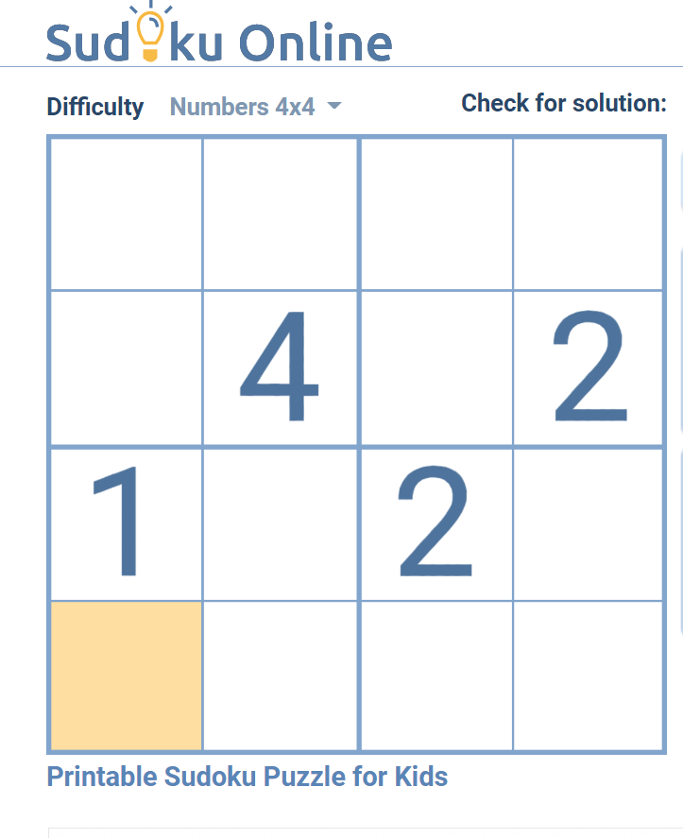
Instructions – part 1
Click here for a Sudoku puzzle
Have a practice!
When I start the timer, have a go at the Sudoku puzzle – keep track of how may you complete (it doesn’t save this for you).
After the timer (5 mins!), complete the (simplified NASA TLX
https://forms.office.com/e/JweHE1f8ER
ACTIVITY!!!!
Notes:
Reminder of NASA TLX
A subjective method for measuring workload during task performance.
Determines overall workload based on ratings on weighted average of six workload sub-scales: mental demand; physical demand; temporal demand; performance; effort; frustration level.
Today, we will take raw scores on each of the sub-scales (albeit modified to Likert-style).

Slide 52
Instructions – part 2
Use same link for the Sudoku puzzle
This time, when you get notification that I’ve asked something in Teams, I want you to respond.
Then, after the timer, complete the form
https://forms.office.com/e/27FwvrC4Fi
Notes:
What’s your favourite food?
What time is it?
What colour is Glyn’s shirt?
When is your next coursework due?
Are you enjoying this task?
Who is your favourite lecturer?!

Slide 53
Implications for design - workload
Considering amount that an individual can cope with​
Mode of information and implications for workload​
How to avoid “precipice of performance?”
Can workload be monitored in the workplace?
Different ways to measure workload in early and later stages of design process​
Using quantitative approaches to justify work design decisions​

Slide 54
Homework (Optional – but recommened)
Use the Rubric to mark the work of 2324 Coursework sample 1
What are you looking for as a marker?
What makes a good paper?
What areas could be improved
You may wish to look at other examples of coursework to get an idea of the relative strengths of each.

Slide 55
Any questions? Kyle.Harrington@nottingham.ac.uk

Slide 56

Overcoming Writer’s Block
“Write with the door closed, rewrite with the door open”
“When you’re writing a story, you’re telling yourself a story. When you rewrite, you’re taking out all the things that are not the story.”
“When you write a book, you spend day after day scanning and identifying trees. When you’re done, you have to step back and look at the forest.”
“For me the answer has always been two drafts and a polish.”
“Eliminate every possible distraction.”

Slide 57
Making a Plan (small man-age-able chunks)
PREPARATION
Read the question
Consider a system or product you are very familiar with and think of examples
Draw out concepts from the lectures and reading materials which may apply
Make notes of these concepts
RESEARCH & PLANNING
Check reading list and further reading for theories and evidence which relates
Download these papers, reference them, document somehow
Make notes of what the papers say and how it relates to what you will do
Organise these notes into different concepts
Think about the central thrust of what you are trying to say
WRITING
Draft headings/ Bullet points on the page
Make each bullet point its own paragraph or two
Sleep on it
Turn from draft into full write up
Sleep on it
Check against the rubric, think like a marker. Edit, revise
Day 1
Day 2+3
Day 4
Day 5
Day 6
Day 7
Final check for spelling, grammar, obvious errors - submit

Slide 58
Referencing Software
EndNote (University Licence) or Mendeley.
Keep track of the things you read.
Integrates into Microsoft word (and other office programs – e.g., Publisher for posters, PowerPoint for presentations).
Allows you to create reference lists with less effort.
Can help you to keep track of notes about each paper.
Allows you to organise papers into categories.

